Slide 1
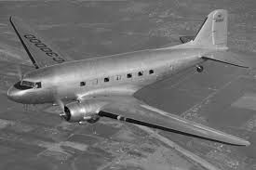
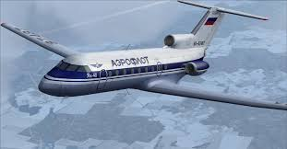
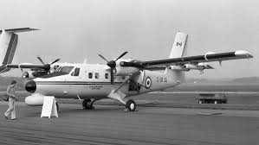
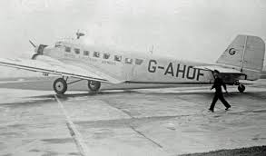
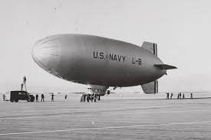
Analysis of Historical Airplane Crashes

Slide 2
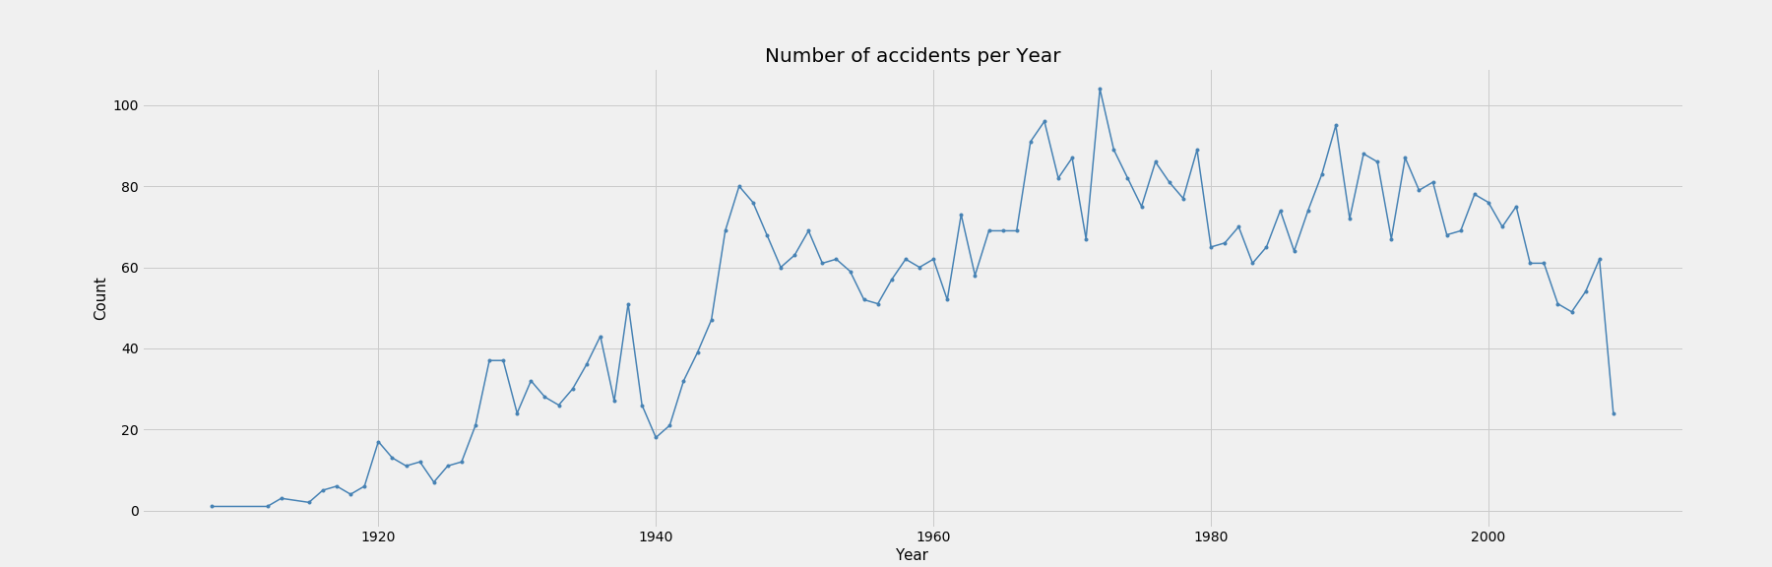
Number of Crashes per Year
What caused the sharp increase in the early 1940’s?
Crashes seem to decline after the 1990’s
Highest number of crashes take place in the 1970’s

Slide 3
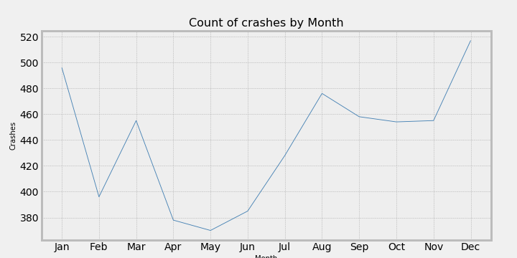
Crashes by month
Does the season effect the probability of a crash?
Most crashes tend to happen in the winter months, why?

Slide 4
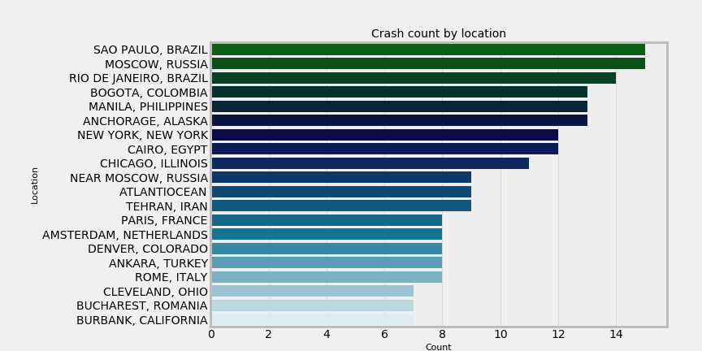
Crashes by Location
Does the crash location have anything to do with the actual crash cause, i.e. weather?

Slide 5
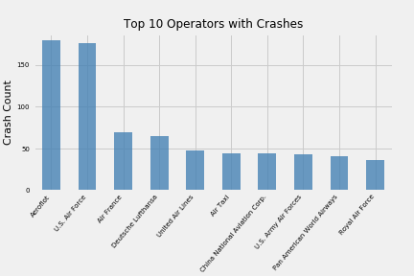
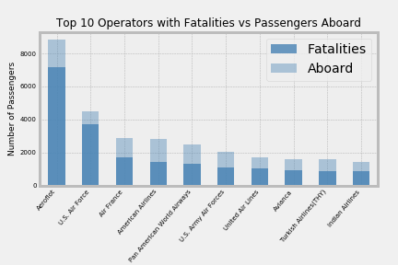
Operators with the highest number of crashes and Fatalities vs. Number of passengers aboard.
Among the Operators with the most fatalities, most have a fairly good survival rate.
Only three of the top operators with the highest number of crashes are military.
Aeroflot is one of the oldest airlines in the world, starting in 1923. During the Soviet Era (1922-1991), Aeroflot was the soviet national airline and the largest airline in the world

Slide 6
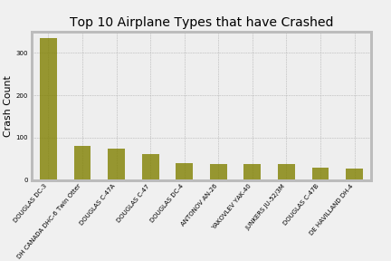
Top 10 Airplanes Types that have crashed
Are the top 10 airplane types commercial or military?

Slide 7
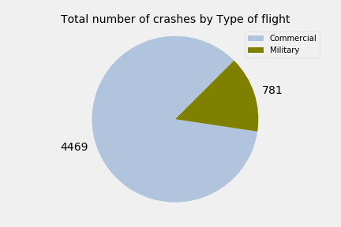
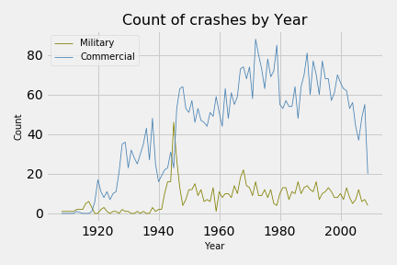
Military vs Commercial Crashes
Do Commercial and Military crashes follow the same pattern over time?
There is a big increase in military crashes, in the early 1940’s, why?
Total Number of Crashes Military vs Commercial
Crashes by year military vs. Commercial

